Slide 1
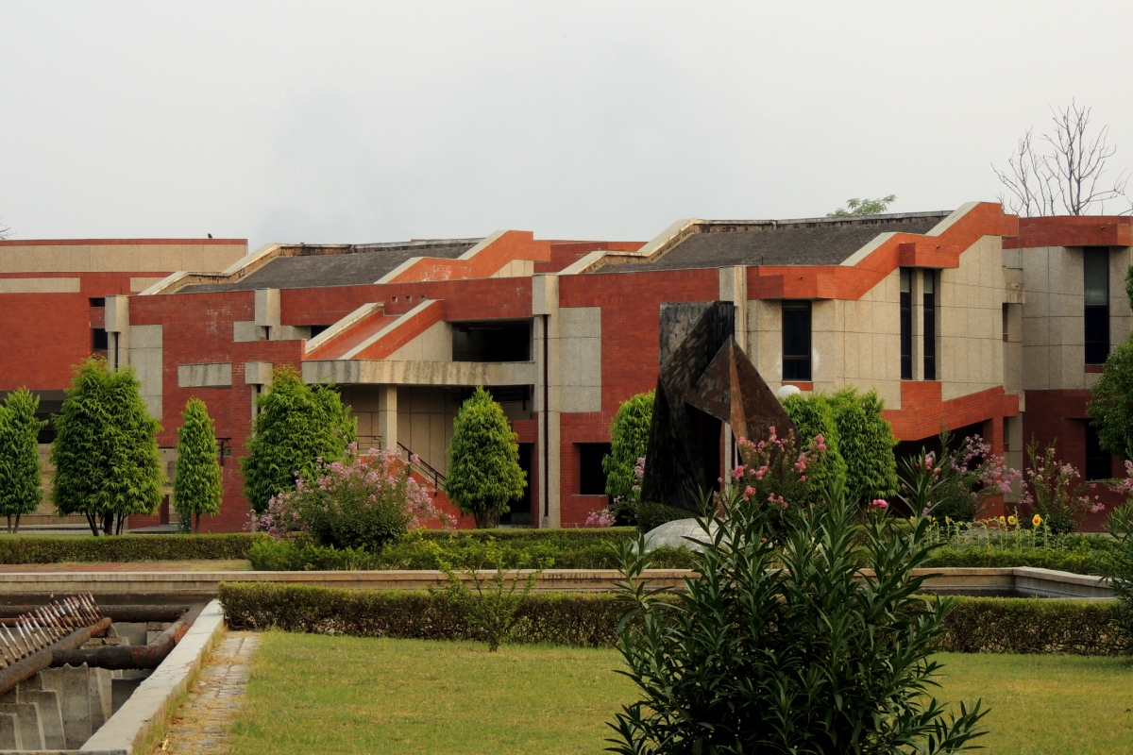


SMARTEX
security simplified
GROUP 16
BIT ENGINE

Slide 2

Acknowledgment
We would like to express our sincere gratitude to our professor MR. Indranil saha Sir for his guidance and support. We are also thankful to our TA Mr. Rumit for his guidance, support and feedback throughout the development of this software. We are also grateful to our group members for their hard work and dedication in bringing this project to fruition. Finally, we would like to thank all those who contributed to the success of this project and helped us overcome the challenges we faced during its development.
Group 16 : BIT ENGINE
SMARTEX

Slide 3

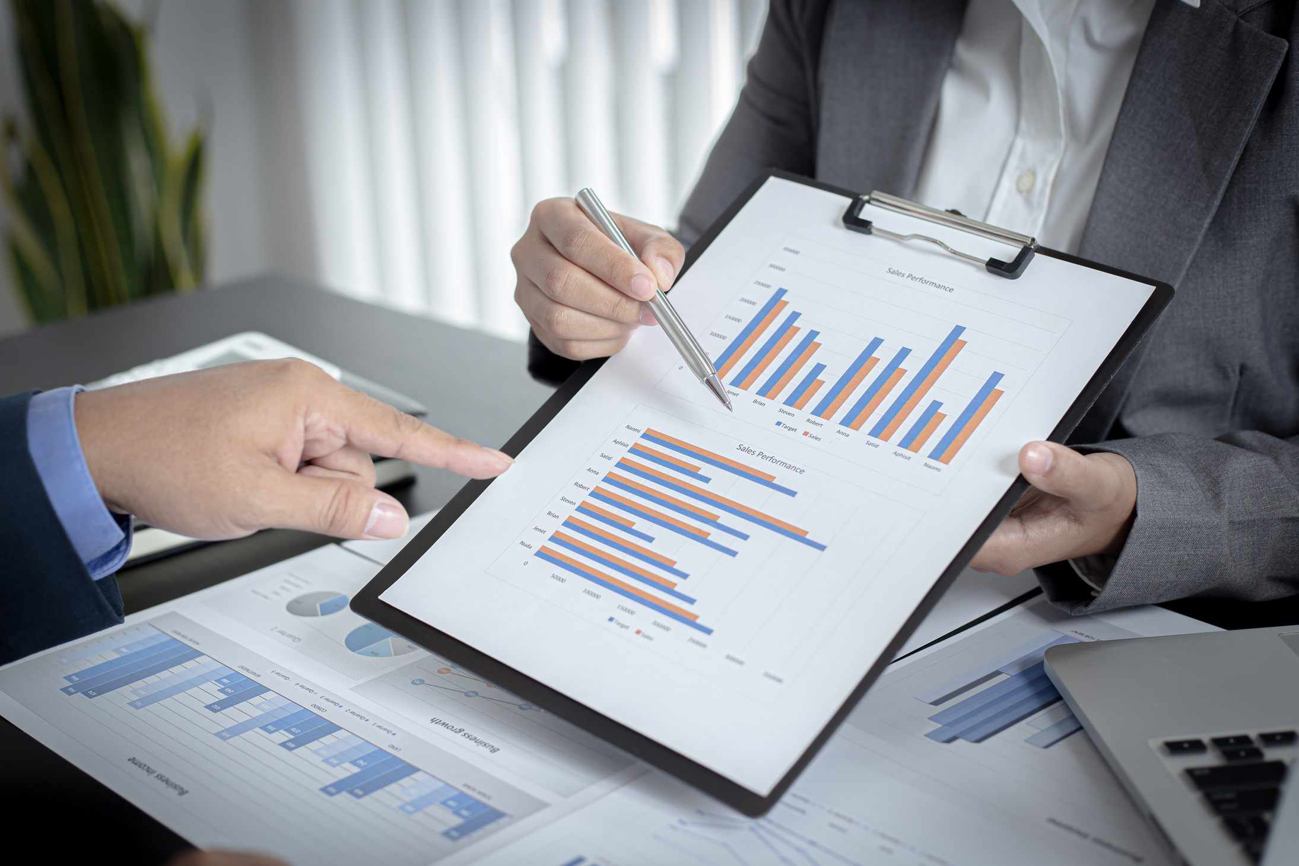
CAEES : Campus Automated Entry-Exit System
Potential Users:
IITK students
IITK Staff
IITK community

Slide 4
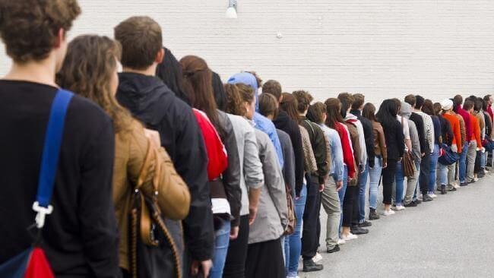
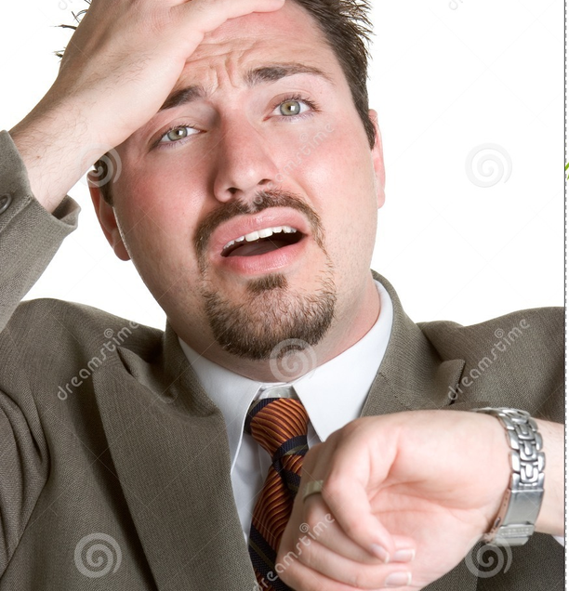


Why this one
Challenges of manual entry- exit due to long queues
Risks of errors in manual entry
Time taking data entries

Slide 5


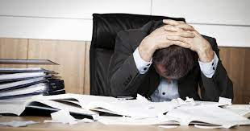

Potential for additional features
Difficulties in managing entry and exit data
Accessing real-time information

Slide 6

MAJOR REQUIREMENTS
User friendly
Integration with existing entry -exit methodology
Availabilty
Optimize Storage capacity

Slide 7
MAJOR REQUIREMENTS
Optimize Storage capacity
Safe and secure use
Maintainable
Customizable to college needs
Support for multiple entry and exit points.
Analytics capabilities

Slide 8

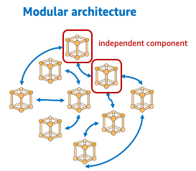

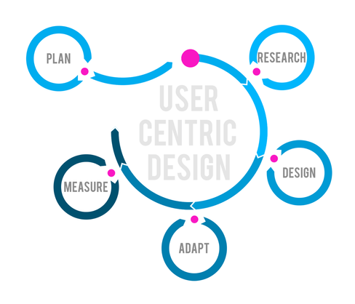
KEY DESIGN
Modular and Scalable Architecture​​
User-friendly Design​
Data Security and Privacy

Slide 9


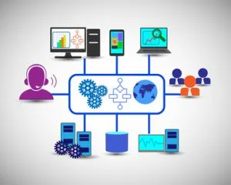

Real-time
Data Management
Integration with
Existing Systems
Security and
Access Controls

Slide 10

IMPLEMENTATION

Slide 11


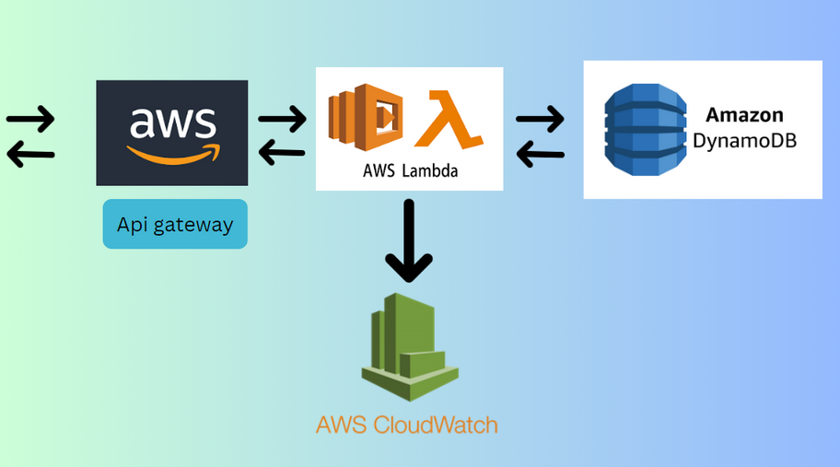
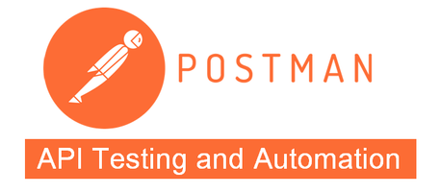


Tools and Technologies

Slide 12
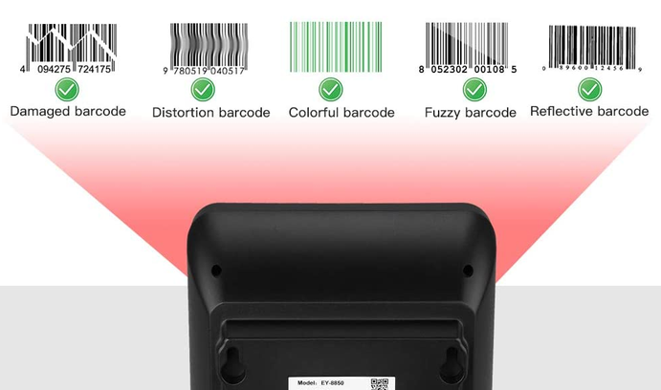



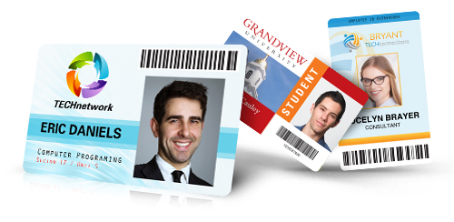

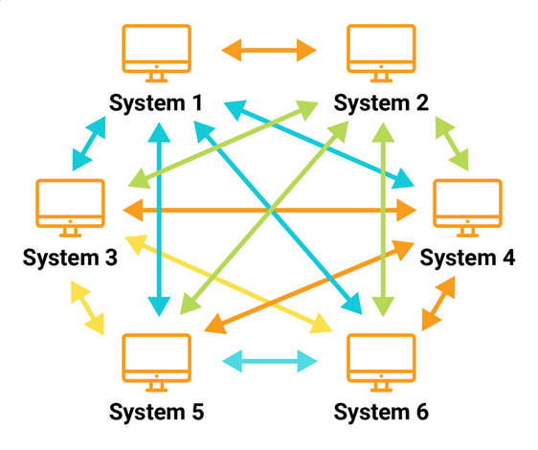

Integration with bar code scanners and student card readers.
Secure login and authentication mechanisms.
Integration with existing manual entry-exit.

Slide 13


Discovery and Planning
Design :Analyzing how to customize software
Deployement and testing
IMPLEMENTATION
Supportive to users as it should be upgradable
Developement
Geographical Location (IITK )

Slide 14


DEMONSTRATION TIME
WEB: https://rikeshsharma.github.io/smartex/index.html ​

Slide 15

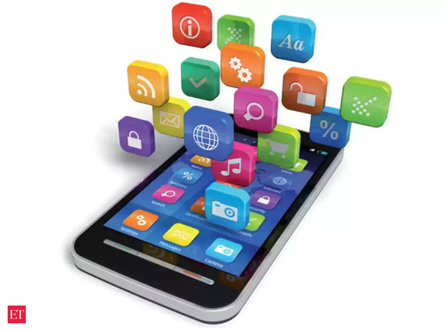
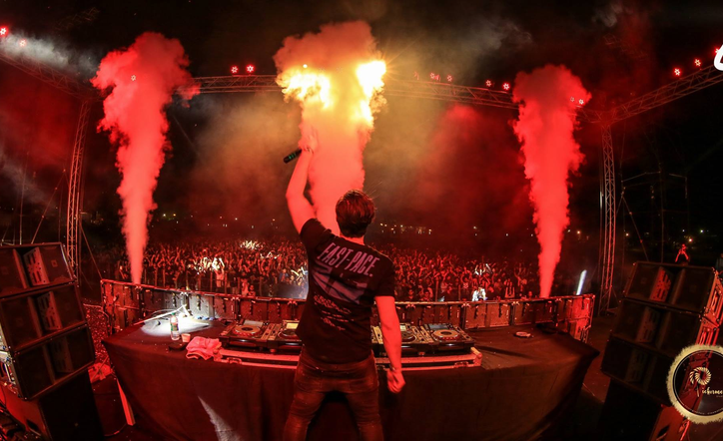
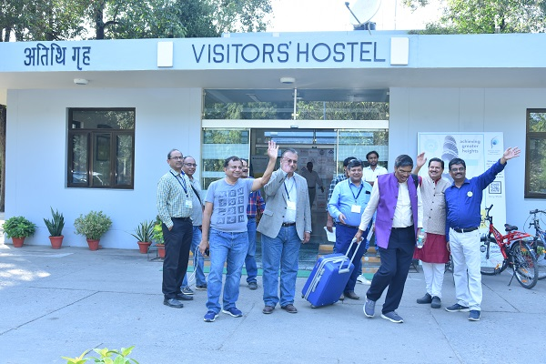

FUTURE PLANS
Integration with advanced biometric technologies
Development of a mobile application

Slide 16

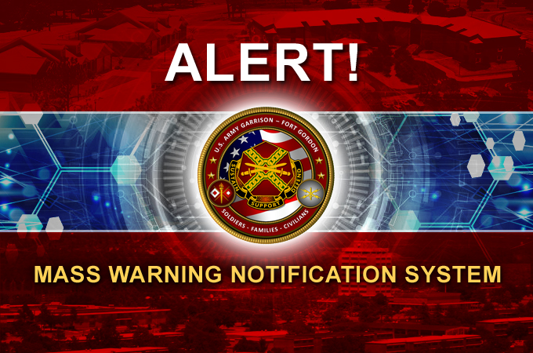
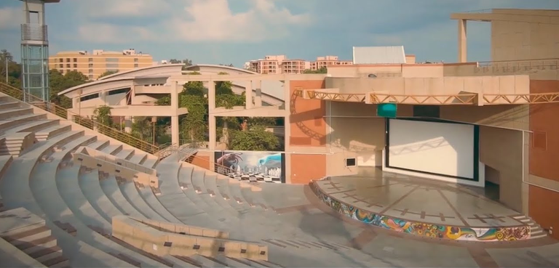
FUTURE PLANS
Notifications and alert system
Development of a visitor management system

Slide 17
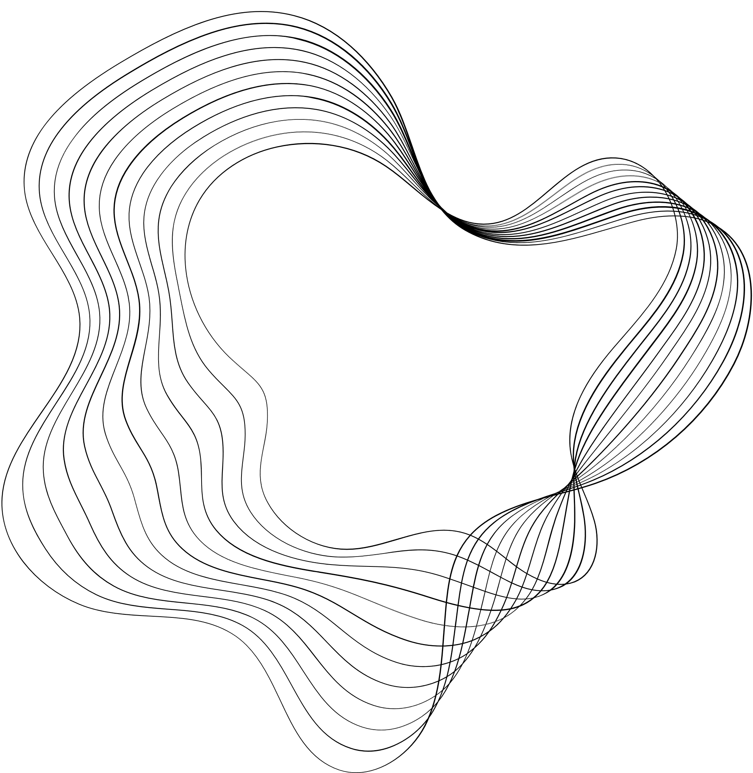



WHAT WE LEARN FROM THIS
1.Collaboration in team is crucial
2. Documentation is essential
3.Communication is key
Team collabration

Slide 18
WHAT WE LEARN FROM THIS
Planning is important but continous improvement is also necessary
Testing and debugging must be perform regularly

Slide 19
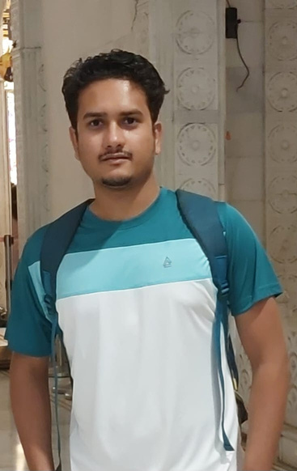
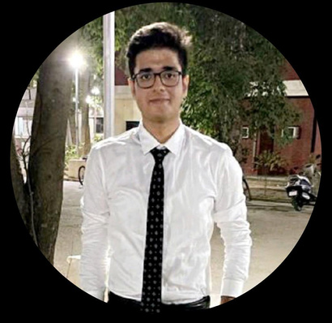
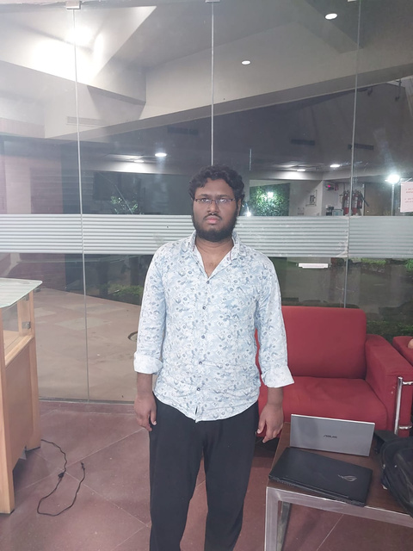
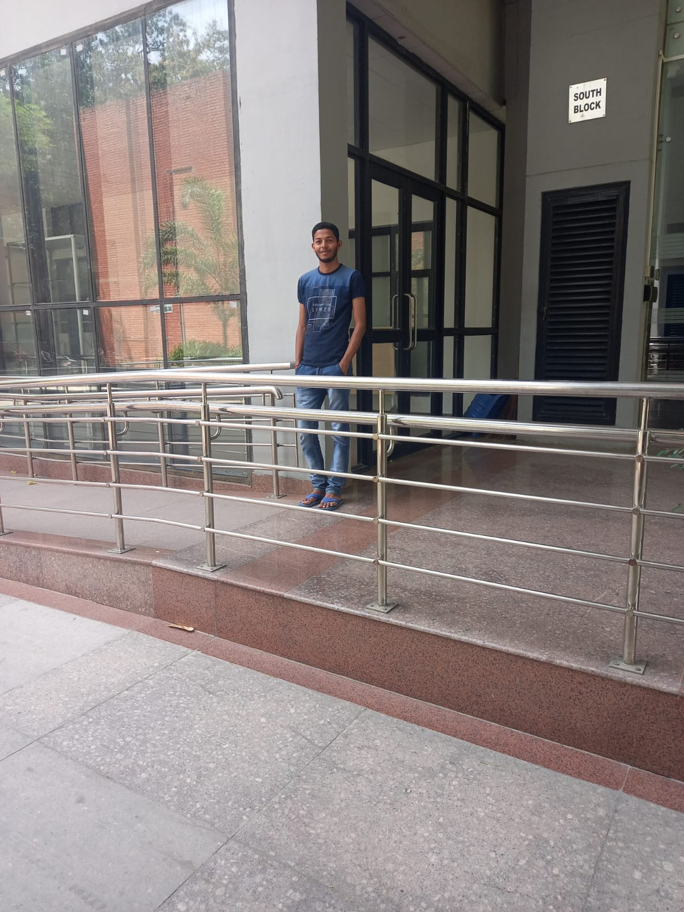
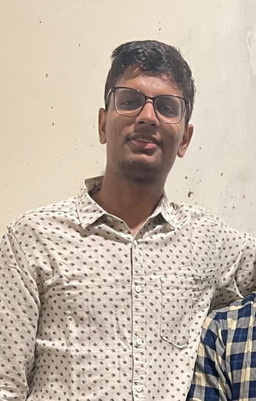
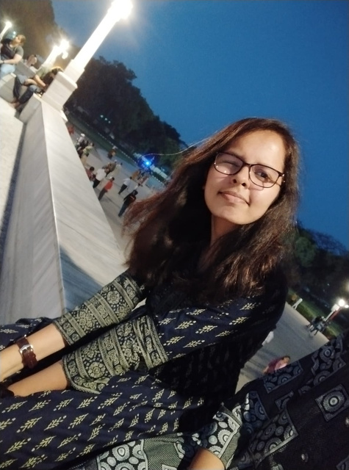
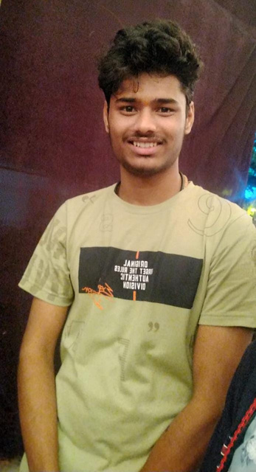
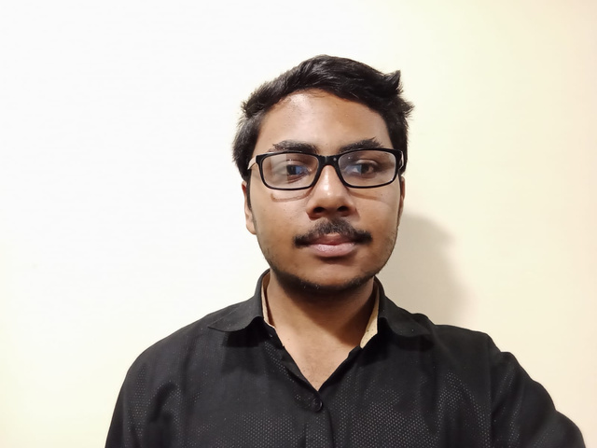
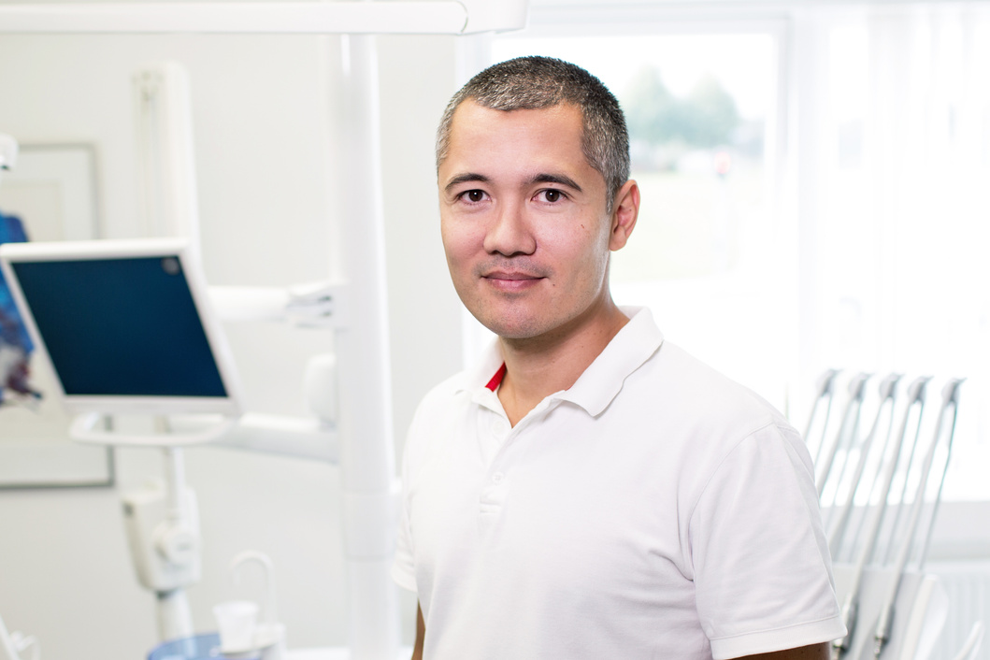
GROUP MEMBERS
RIKESH
180606
DANISH
210297
GAURAV
170353
AJEET
210078
AVINASH
200232
PRATIKSHA
210760
LOHIT
210564
ANUJ
200232

Slide 20

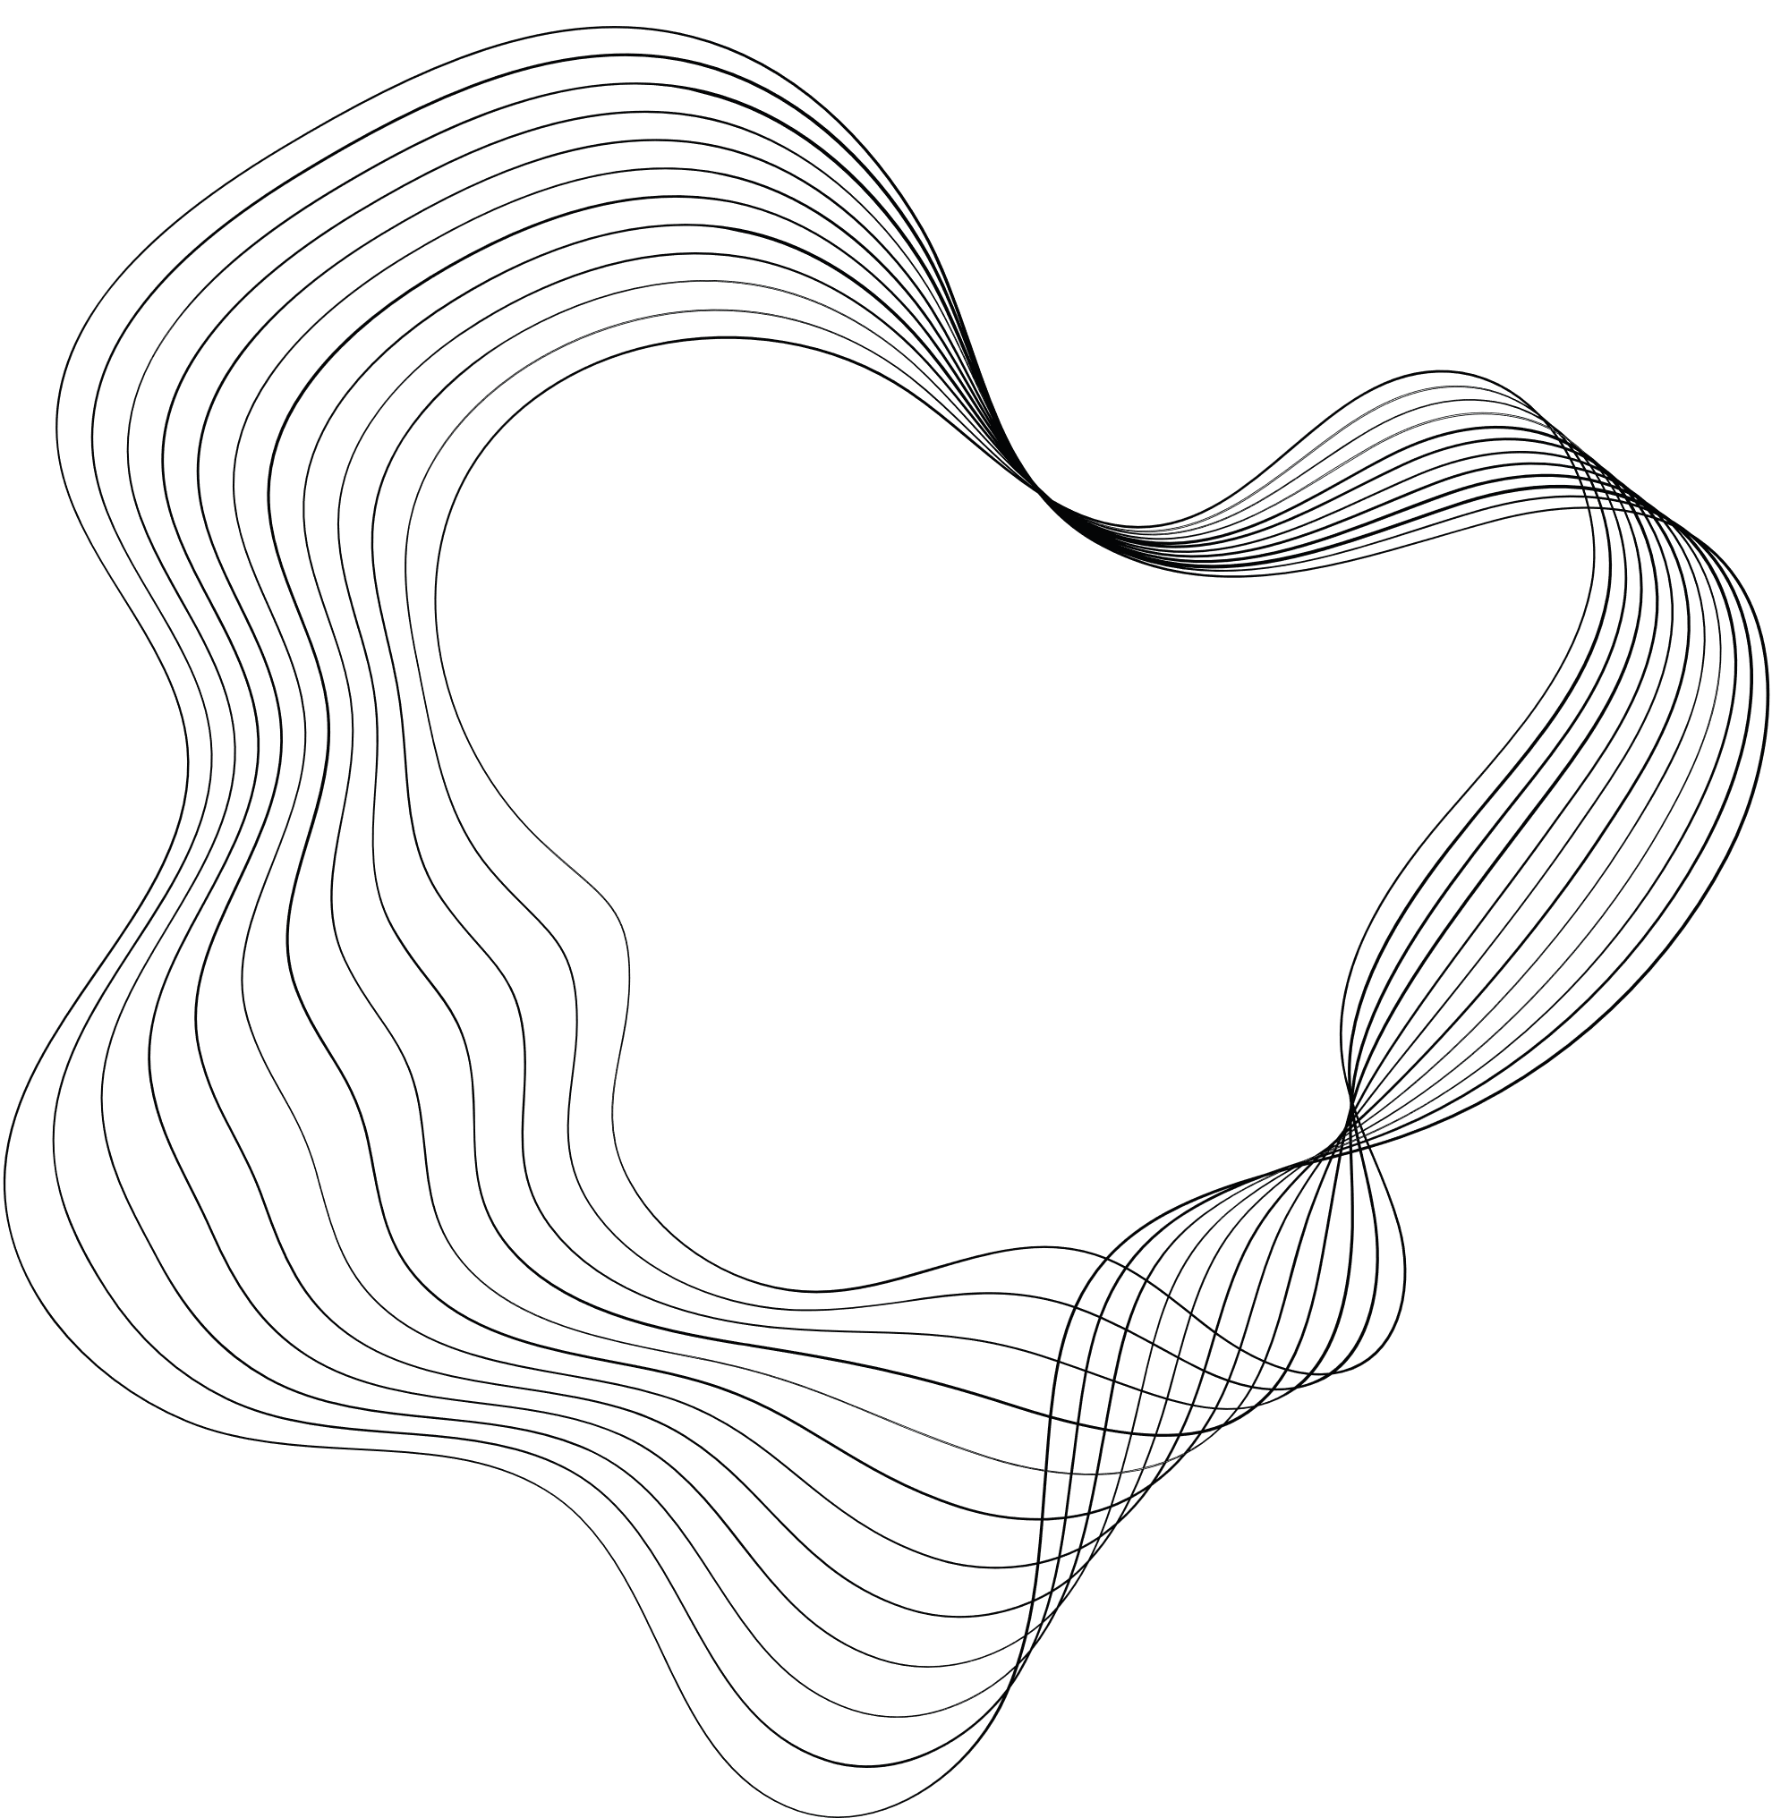


Questions?

Slide 21

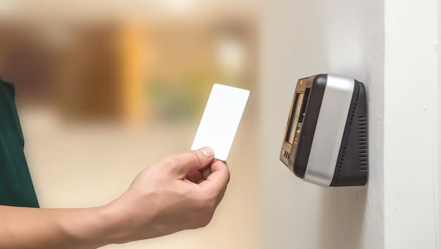

Thank
you

